Slide 1

Man in the Middle
Tales of
trust and betrayal
2020
Satria Ady Pradana

Slide 2





Hi!
I am Satria Ady Pradana
Cyber Security Consultant at Mitra Integrasi Informatika
Community Leader of Reversing.ID
R&D Member of Indonesia Honeynet Project
Researcher
xathrya
https://xathrya.id
@xathrya
Reversing.ID
Revealing the Truth through Breaking Things

Slide 3
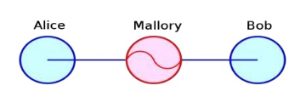
Man in the Middle (MITM)
Also known as:
Bucket-Brigade Attack
Eavesdropping

Slide 4
Man in the Middle (MITM)
Eavesdropping.
Positioning self between two communicating parties.
Able to monitor, relay, and possibly alter the messages.
(Usually) Tricking each parties, impersonate as the other side of communication.
Using or act as proxy in the middle ground.

Slide 5
Man in the Middle (MITM)
Derived from the basketball scenario.
Two players intend to pass a ball to each other while one player between them tries to seize it.

Slide 6
Who Use MITM?
Hackers, attacking people in vicinity, to sniff or steals data.
Security researcher, targeting his own hardware or application, to learn the behavior.

Slide 7
Impact
In most cases:
Credentials stolen.
Activity monitored.
Tamper messages.

Slide 8
Techniques

Slide 9
MITM: Types
Based on Interactions
Passive
Active
Based on Level of Proximity
Application Level
Network Level
Hardware Level
Based on Attacks
Rogue Access Point
Identity Spoofing

Slide 10
MITM: Passive
Quietly monitor messages.
Capturing information in transit without modify any part in any way.
Modifying the infrastructure, not the target.

Slide 11
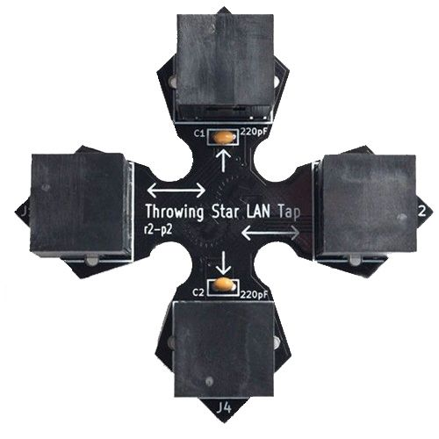
Network Tapping
Introduce middle point in communication line.
Copy the messages in traffic.
No transit, no controlling flow.

Slide 12
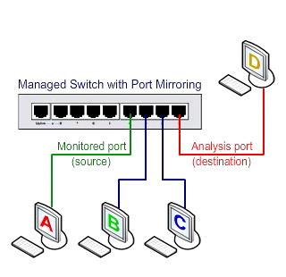
Port Mirroring
Also known as SPAN (Switched Port Analyzer)
Feature of most enterprise-class switches (managed switches).
Forward in/out traffic of specific port to other port.

Slide 13
MITM: Active
Periodically send requests.
Modify application or machine behavior to redirect messages.
Force request to transit to proxy, unbeknownst.

Slide 14
Application-Level MITM
Application to application communication.
Intercomponent communication.
Altering applications behavior.
Hooking functions.
Example classes:
Man in The Browser

Slide 15
Network Level MITM
Host to host communication.
Techniques:
Rogue Access Point
ARP Spoofing
DNS Spoofing
DHCP Spoofing

Slide 16
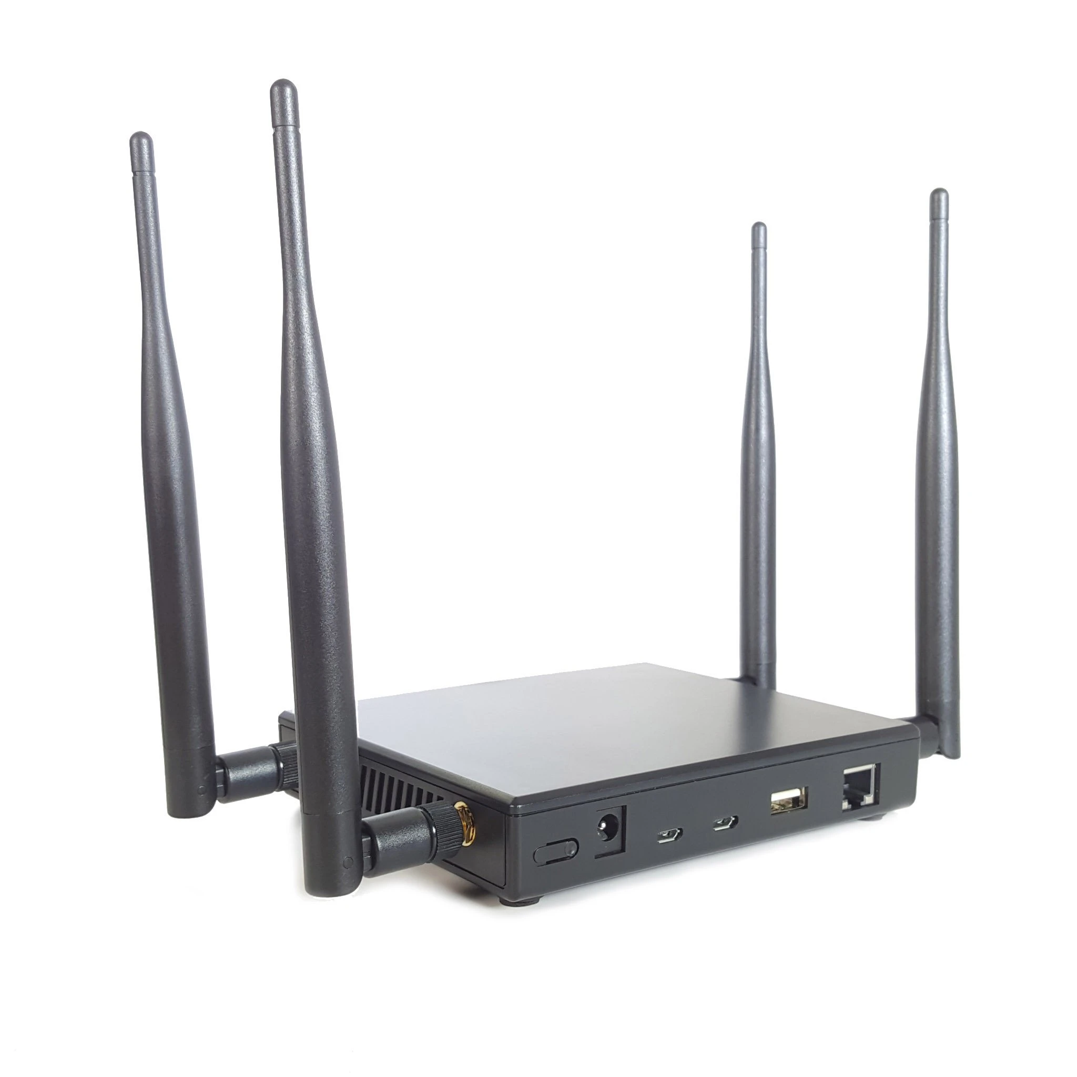

Rogue Access Point
Pretend as legitimate Access Point.
Trick nearby devices to join.

Slide 17
ARP Spoofing
Address Resolution Protocol
Convert / map IP address into physical address (MAC).
Switch know MAC addresses, router know IP addresses.
Sent packets to modify ARP cache table.
Usually attacker imposing as gateway.

Slide 18
DNS Spoofing
Domain Name System
Convert domain name to IP address.
Machine use IP address fluently, human remember words better.
Send packets to corrupt and modify DNS cache information.
Usually sniffing ID of any DNS request and reply before the real DNS server.

Slide 19
DHCP Spoofing
Dynamic Host Configuration Protocol
Set up host IP address, gateway, DNS server, and subnet dynamically.
Give desired configuration to victim.
DHCP requests are made in broadcast mode.
Reply to machine DHCP requests before real DHCP server answer.
IP address of victim.
Gateway address assigned to

Slide 20
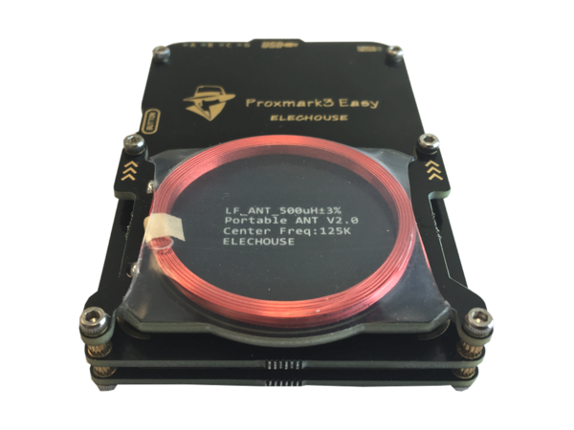
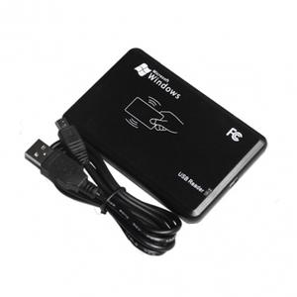
Hardware-Level MITM
Targeting contactless devices (proximity card, RFID, NFC, etc).
Commonly used to relay and replay messages.

